Slide 1
My Spelling List
my weekly spelling
glue spelling list here!
______________________________

Slide 2
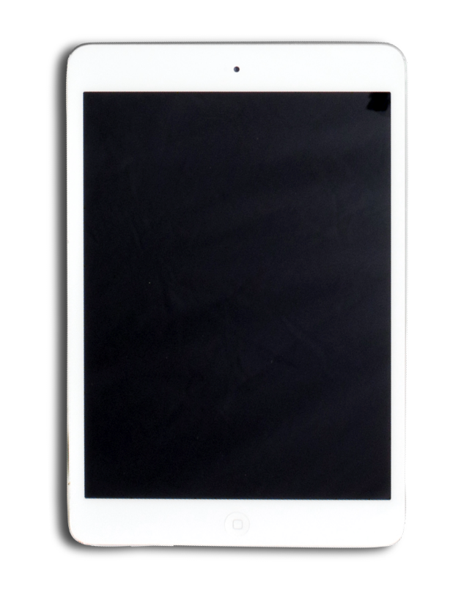
Ghost Word Monday
Text it out Tuesday
Monday
Tuesday
Write your spelling words in white crayon. Once you are finished, take a Crayola marker and color over the blank page.
Write funny text messages to Mrs. Boston using all of your spelling words.

Slide 3
Wacky Word Wednesday
Tic-Tac-Toe Thursday
Wednesday
Thursday
Write your spelling words as objects that match the theme of the image below!
Choose 2 of the trickiest words for you to spell and play 2 rounds of tic-tac-toe with a partner.

Slide 4
Wacky Word Wednesday
Tic-Tac-Toe Thursday
Wednesday
Thursday
Write your spelling words as objects that match the theme of the image below!
Choose 2 of the trickiest words for you to spell and play 2 rounds of tic-tac-toe with a partner.

Slide 5
Fluency Friday!
Spelling test!
Friday
Test!
Read your words in your thought bubble, read them to a partner, then read them to Mrs. Boston!
When you are finished, review the spelling of your words and get ready for your spelling test!
1.___________________________
2 .___________________________
3 .___________________________
4 .___________________________
5 .___________________________
6 .___________________________
7 .___________________________
8 .___________________________
9 .___________________________
10 .__________________________
Total Words Mastered___________

Slide 6
Spelling Lists
Spelling Pre-test!
Teacher
pre-test
1. happen
2. lesson
3. middle
4. pretty
5. puddle
6. balloon
7. ladder
8. worry
9. traffic
10. address
1.___________________________
2 .___________________________
3 .___________________________
4 .___________________________
5 .___________________________
6 .___________________________
7 .___________________________
8 .___________________________
9 .___________________________
10 .__________________________
Total Words to learn this week____
1. happen
2. lesson
3. middle
4. pretty
5. puddle
6. balloon
7. ladder
8. worry
9. traffic
10. address

Slide 7
Spelling Lists
Spelling Pre-test!
Teacher
pre-test
1. funny
2. hurry
3. empty
4. lazy
5. messy
6. lucky
7. smelly
8. fancy
9. happy
10. candy
1.___________________________
2 .___________________________
3 .___________________________
4 .___________________________
5 .___________________________
6 .___________________________
7 .___________________________
8 .___________________________
9 .___________________________
10 .__________________________
Total Words to learn this week____
1. happen
2.
3.
4.
5.
6.
7.
8.
9.
10.

Slide 8
Spelling Lists
Spelling Pre-test!
Teacher
pre-test
want
then
when
1.___________________________
2 .___________________________
3 .___________________________
4 .___________________________
5 .___________________________
6 .___________________________
7 .___________________________
8 .___________________________
9 .___________________________
10 .__________________________
Total Words to learn this week____

Slide 9
