Slide 1
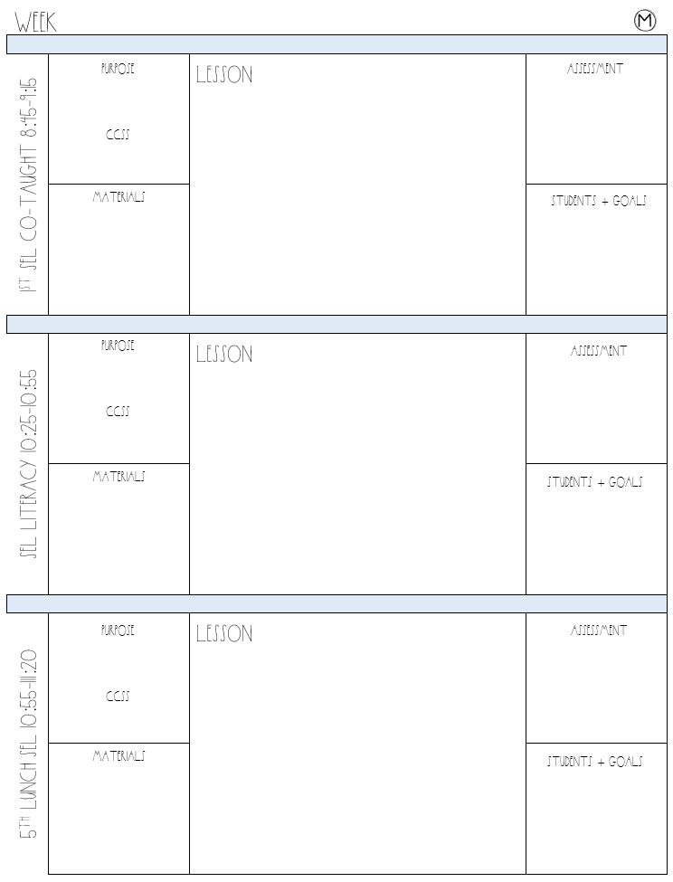
EDITABLE: Lesson Planning Resource for Special Education Teachers
Special Education
Daily lesson planner
The Teacher Dress Code

Slide 2
Special Education
Weekly lesson planner

Slide 3
Week
M
Purpose
ccss
lesson
Assessment
1st sel co-taught 8:45-9:15
Materials
Students + goals
Purpose
ccss
lesson
Assessment
Sel literacy 10:25-10:55
Materials
Students + goals
Purpose
ccss
lesson
Assessment
5th lunch sel 10:55-111:20
Materials
Students + goals

Slide 4
Week
M
Purpose
ccss
lesson
Assessment
2nd writing 11:20-11:50
Materials
Students + goals
Purpose
ccss
lesson
Assessment
5TH WRITING 1 11:55-12:25
Materials
Students + goals
Purpose
ccss
lesson
Assessment
5TH READING COMP 12:25-12:55
Materials
Students + goals

Slide 5
Week
M
Purpose
ccss
lesson
Assessment
5TH DECODING 12:55-1:25
Materials
Students + goals
Purpose
ccss
lesson
Assessment
5TH SEL 1 1:25-1:40 – extra recess
Materials
Students + goals
Purpose
ccss
lesson
Assessment
5TH MATH 1 1:55-2:35
Materials
Students + goals

Slide 6
Week
M
Purpose
ccss
lesson
Assessment
5TH MATH 2 2:30-3:00
Materials
Students + goals
Purpose
ccss
lesson
Assessment
5TH CHECK-OUT 3:00-3:10
Materials
Students + goals
Daily Schedule
To-do
Data
8:45-9:15 1st SEL 9:15-9:45 Lunch 9:45-10:25 Planning 10:25-10:55 SEL Literacy 10:55-11:20 5th Lunch 11:20-11:50 2nd Writing 11:55-12:25 5th Writing 12:25-12:55 5th Reading 12:55-1:25 5th Decoding 1:25-1:40 5th SEL 1:40-1:55 CI w/ Ana 1:55-2:10 Recess JB 2:15 Math 1 2:30-3:00 Math 2 3:00-3:10 Check-out
#TEACHERLIFE

Slide 7
Week
T
Purpose
ccss
lesson
Assessment
Schedule
Materials
Students + goals
Purpose
ccss
lesson
Assessment
Schedule
Materials
Students + goals
Purpose
ccss
lesson
Assessment
Schedule
Materials
Students + goals

Slide 8
Week
T
Purpose
ccss
lesson
Assessment
Schedule
Materials
Students + goals
Purpose
ccss
lesson
Assessment
Schedule
Materials
Students + goals
Purpose
ccss
lesson
Assessment
Schedule
Materials
Students + goals

Slide 9
Week
T
Purpose
ccss
lesson
Assessment
Schedule
Materials
Students + goals
Purpose
ccss
lesson
Assessment
Schedule
Materials
Students + goals
Purpose
ccss
lesson
Assessment
Schedule
Materials
Students + goals

Slide 10
Week
T
Purpose
ccss
lesson
Assessment
Schedule
Materials
Students + goals
Purpose
ccss
lesson
Assessment
Schedule
Materials
Students + goals
Daily Schedule
To-do
Data
8:45-9:15 1st SEL 9:15-9:45 Lunch 9:45-10:25 Planning 10:25-10:55 SEL Literacy 10:55-11:20 5th Lunch 11:20-11:50 2nd Writing 11:55-12:25 5th Writing 12:25-12:55 5th Reading 12:55-1:25 5th Decoding 1:25-1:40 5th SEL 1:40-1:55 CI w/ Ana 1:55-2:25 Math 1 2:30-3:00 Math 2 3:00-3:10 Check-out
#TEACHERLIFE

Slide 11
Week
W
Purpose
ccss
lesson
Assessment
Schedule
Materials
Students + goals
Purpose
ccss
lesson
Assessment
Schedule
Materials
Students + goals
Purpose
ccss
lesson
Assessment
Schedule
Materials
Students + goals

Slide 12
Week
W
Purpose
ccss
lesson
Assessment
Schedule
Materials
Students + goals
Purpose
ccss
lesson
Assessment
Schedule
Materials
Students + goals
Purpose
ccss
lesson
Assessment
Schedule
Materials
Students + goals

Slide 13
Week
W
Purpose
ccss
lesson
Assessment
Schedule
Materials
Students + goals
Purpose
ccss
lesson
Assessment
Schedule
Materials
Students + goals
Daily Schedule
To-do
Data
8:45-9:15 5th Literacy 10:25-10:55 3rd SEL 10:55-11:15 5th Lunch
11:15-11:25 2nd Writing
11:40-12:30 RTI Math
12:30-12:50 Check-out
#TEACHERLIFE

Slide 14
Week
TH
Purpose
ccss
lesson
Assessment
Schedule
Materials
Students + goals
Purpose
ccss
lesson
Assessment
Schedule
Materials
Students + goals
Purpose
ccss
lesson
Assessment
Schedule
Materials
Students + goals

Slide 15
Week
TH
Purpose
ccss
lesson
Assessment
Schedule
Materials
Purpose
ccss
lesson
Assessment
Schedule
Materials
Purpose
ccss
lesson
Assessment
Schedule
Materials

Slide 16
Week
TH
Purpose
ccss
lesson
Assessment
Schedule
Materials
Purpose
ccss
lesson
Assessment
Schedule
Materials
Purpose
ccss
lesson
Assessment
Schedule
Materials

Slide 17
Week
TH
Purpose
ccss
lesson
Assessment
Schedule
Materials
Students + goals
Purpose
ccss
lesson
Assessment
Schedule
Materials
Students + goals
Daily Schedule
To-do
Data
8:45-9:15 1st SEL 9:15-9:45 Lunch 9:45-10:25 Planning 10:25-10:55 SEL Literacy 10:55-11:20 5th Lunch 11:20-11:50 2nd Writing 11:55-12:25 5th Writing 12:25-12:55 5th Reading 12:55-1:25 5th Decoding 1:25-1:40 5th SEL 1:40-1:55 CI w/ Ana 1:55-2:10 Recess JB 2:15 Math 1 2:30-3:00 Math 2 3:00-3:10 Check-out
#TEACHERLIFE

Slide 18
Week
F
Purpose
ccss
lesson
Assessment
Schedule
Materials
Students + goals
Purpose
ccss
lesson
Assessment
Schedule
Materials
Students + goals
Purpose
ccss
lesson
Assessment
Schedule
Materials
Students + goals

Slide 19
Week
F
Purpose
ccss
lesson
Assessment
Schedule
Materials
Students + goals
Purpose
ccss
lesson
Assessment
Schedule
Materials
Students + goals
Purpose
ccss
lesson
Assessment
Schedule
Materials
Students + goals

Slide 20
Week
F
Purpose
ccss
lesson
Assessment
Schedule
Materials
Students + goals
Purpose
ccss
lesson
Assessment
Schedule
Materials
Students + goals
Purpose
ccss
lesson
Assessment
Schedule
Materials
Students + goals

Slide 21
Week
F
Purpose
ccss
lesson
Assessment
Schedule
Materials
Students + goals
Purpose
ccss
lesson
Assessment
Schedule
Materials
Students + goals
Daily Schedule
To-do
Data
8:45-9:15 1st SEL 9:15-9:45 Lunch 9:45-10:25 Planning 10:25-10:55 SEL Literacy 10:55-11:20 5th Lunch 11:20-11:50 2nd Writing 11:55-12:25 5th Writing 12:25-12:55 5th Reading 12:55-1:25 5th Decoding 1:25-1:40 5th SEL 1:40-1:55 CI w/ Ana 1:55-2:10 Recess JB 2:15 Math 1 2:30-3:00 Math 2 3:00-3:10 Check-out
#TEACHERLIFE

