Slide 1
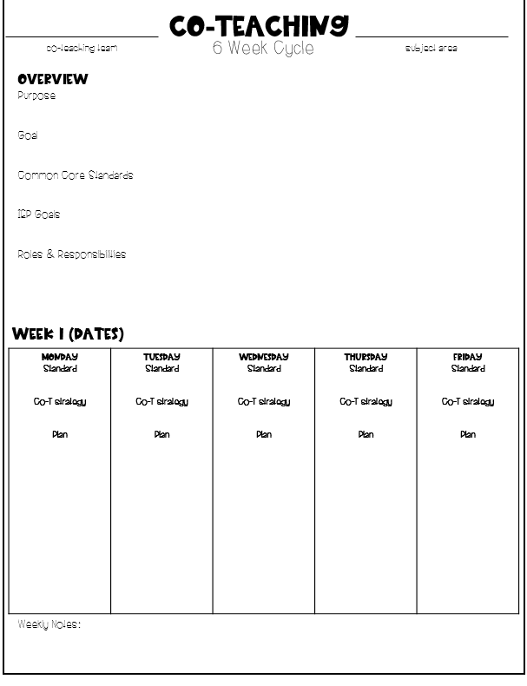
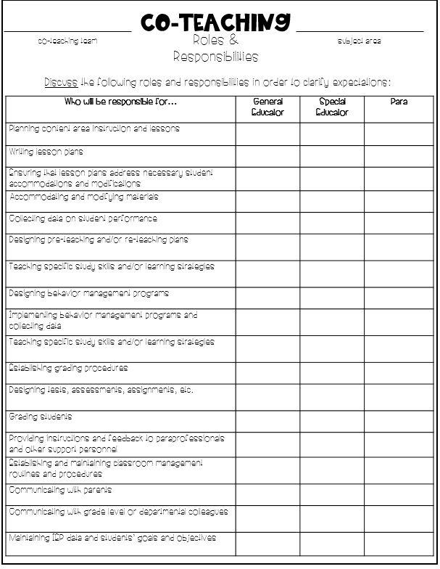
The real resources I use!
co-teaching binder
First steps and resources
co-teaching team alignment resources
assessment resources
planning resources & more!
The Teacher Dress Code

Slide 2
grade co-teaching
names

Slide 3
names
grade co-teaching

Slide 4
Co-teaching
last name, first name
Student Profile
co-teaching team
Student Information
Race F/R Lunch Services
Co-teaching subject area Reading Writing Math
Student Strengths
Areas of Growth
Data Collection
Baseline Measure(s) STAR IEP PM RUBRIC CCSS
Date/Purpose | Measure | Score | +/-
Baseline:
DP #1:
DP #2:
DP #3:
Anecdotal Data + information
Instructional Strategies that work well:
Behavioral Strategies that work well:
Accommodations + Modifications that work:

Slide 5
Co-teaching
last name, first name
Student Profile
co-teaching team
Student Information
Race F/R Lunch Services
Co-teaching subject area Reading Writing Math
Student Strengths
Areas of Growth
Data Collection
Baseline Measure(s) STAR IEP PM RUBRIC CCSS
Date/Purpose | Measure | Score | +/-
Baseline:
DP #1:
DP #2:
DP #3:
Anecdotal Data + information
Instructional Strategies that work well:
Behavioral Strategies that work well:
Accommodations + Modifications that work:

Slide 6
Co-teaching
P
Student Assessment
Name_________________________ Grade_______________
My co-teachers are___________________________________
1. I like having two teachers
2. Both my teachers teach me new things
3. Learning is fun
4. I feel good as a math reader
5. I feel good as a math writer
6. I feel good as a mathematician
7. I like sitting on the carpet and listening
8. I like working in a small group
9. Working in a small group is fun
10. I can ask both my teachers for help
11. Both my teachers care about me
12. Both my teachers care about my learning
13. I see people that look like me in my learning

Slide 7
Co-teaching
P
Student Assessment
14. I understand the directions after they are given
15. I learn best by listening to my teacher
16. I learn best by watching a demonstration
17. I learn best when my hands are moving
18. I like staying in my classroom to learn
19. I like going to another classroom to learn
20. I like learning on the computer

Slide 8
Co-teaching
I
Student Assessment
Name_________________________ Grade_______________
My co-teachers are___________________________________
Directions: Circle your level of agreement for each statement listed below.
1. I like having two teachers
2. Both my teachers teach me new things
3. Learning is fun
4. I feel good as a reader
5. I feel good as a writer
6. I feel good as a mathematician
7. I like sitting on the carpet and listening
8. I like working in a small group
9. Working in a small group is fun
10. I can ask both my teachers for help
11. Both my teachers care about me
12. Both my teachers care about my learning
13. I see people that look like me in my learning
strongly disagree disagree agree strongly agree
strongly disagree disagree agree strongly agree
strongly disagree disagree agree strongly agree
strongly disagree disagree agree strongly agree
strongly disagree disagree agree strongly agree
strongly disagree disagree agree strongly agree
strongly disagree disagree agree strongly agree
strongly disagree disagree agree strongly agree
strongly disagree disagree agree strongly agree
strongly disagree disagree agree strongly agree
strongly disagree disagree agree strongly agree
strongly disagree disagree agree strongly agree
strongly disagree disagree agree strongly agree

Slide 9
Co-teaching
co-teaching team
6 Week Cycle
subject area
Overview
Purpose
Goal
Common Core Standards
IEP Goals
Roles & Responsibilities
week 1 (dates)
Monday Standard Co-T strategy Plan | Tuesday Standard Co-T strategy Plan | Wednesday Standard Co-T strategy Plan | Thursday Standard Co-T strategy Plan | Friday Standard Co-T strategy Plan
Weekly Notes:

Slide 10
week 2 (dates)
Monday Standard Co-T strategy Plan | Tuesday Standard Co-T strategy Plan | Wednesday Standard Co-T strategy Plan | Thursday Standard Co-T strategy Plan | Friday Standard Co-T strategy Plan
Weekly Notes:
week 3 (dates)
Monday Standard Co-T strategy Plan | Tuesday Standard Co-T strategy Plan | Wednesday Standard Co-T strategy Plan | Thursday Standard Co-T strategy Plan | Friday Standard Co-T strategy Plan
Weekly Notes:

Slide 11
week 4 (dates)
Monday Standard Co-T strategy Plan | Tuesday Standard Co-T strategy Plan | Wednesday Standard Co-T strategy Plan | Thursday Standard Co-T strategy Plan | Friday Standard Co-T strategy Plan
Weekly Notes:
week 5 (dates)
Monday Standard Co-T strategy Plan | Tuesday Standard Co-T strategy Plan | Wednesday Standard Co-T strategy Plan | Thursday Standard Co-T strategy Plan | Friday Standard Co-T strategy Plan
Weekly Notes:

Slide 12
week 6 (dates)
Monday Standard Co-T strategy Plan | Tuesday Standard Co-T strategy Plan | Wednesday Standard Co-T strategy Plan | Thursday Standard Co-T strategy Plan | Friday Standard Co-T strategy Plan
Weekly Notes:
Co-teaching intervention review
Final Data Point
Student co-teaching post-assessment
Teacher co-teaching post-assessment
Student Work Samples
Data Review
Proposed Adjustment to intervention Plan
Co-teaching Team Collaboration Meeting

Slide 13
Co-teaching
co-teaching team
S.H.A.R.E Assessment
subject area
Sharing Hopes, Attitudes, Responsibilities, and Expectations
­Directions: Take a few minutes to individually complete this worksheet. Be honest in your responses. After completing it individually, share the responses with your co-­teaching partner by taking turns reading the responses. Do not use this time to comment on your partner's responses - merely read. After reading through the responses, take a moment or two to jot down any thoughts you have regarding what your partner has said. Then, come back together and begin to share reactions to the responses. Your goal is to either ( a) Agree, (b) Compromise, or (c) Agree to Disagree.
1. Right now, the main hope I have regarding this co-teaching situation is:
2. My attitude/philosophy regarding teaching students with disabilities in a general education classroom is:
3. I would like to have the following responsibilities in a co-taught classroom:
4. I would like my co-teacher to have the following responsibilities:
5. I have the following expectations in a classroom:
(a) regarding discipline­
(b) regarding classwork ­
( c) regarding materials ­
(d) regarding homework ­
(e) regarding planning ­
(f) regarding modifications for individual students ­
(g) regarding grading
(h) regarding noise level ­
(i) regarding cooperative learning
J) regarding giving/receiving feedback
(k) other important expectations I have­:
Self-Assessment adapted from “Understanding Coaching Components” by S.E Gately and F.j Gately, 2001

Slide 14
Co-teaching
co-teaching team
Roles & Responsibilities
subject area
Discuss the following roles and responsibilities in order to clarify expectations:
Who will be responsible for… | General Educator | Special Educator | Para
Planning content area instruction and lessons
Writing lesson plans
Ensuring that lesson plans address necessary student accommodations and modifications
Accommodating and modifying materials
Collecting data on student performance
Designing pre-teaching and/or re-teaching plans
Teaching specific study skills and/or learning strategies
Designing behavior management programs
Implementing behavior management programs and collecting data
Teaching specific study skills and/or learning strategies
Establishing grading procedures
Designing tests, assessments, assignments, etc.
Grading students
Providing instructions and feedback to paraprofessionals and other support personnel
Establishing and maintaining classroom management routines and procedures
Communicating with parents
Communicating with grade level or departmental colleagues
Maintaining IEP data and students’ goals and objectives

Slide 15
Co-teaching
co-teaching team
Planning Log
subject area
Date | Time
Date | Time

Slide 16
Co-teaching
co-teaching team
Instruction Cheat-sheet
subject area
If one of you is doing this... | The other can be doing this…
Lecturing | Modeling note taking on the board/overhead; Ensuring “brain breaks” to help students process lecture information
Taking roll | Collecting and reviewing last night’s homework; Introducing a social or study skills
Passing out papers | Reviewing directions; Modeling first problem on the assignment
Giving instructions orally | Writing down instructions board; Repeating or clarifying any difficult concept
Checking for understanding with large heterogeneous group of student | Checking for understanding with small heterogeneous group of students
Circulating, providing one-on-one support as needed | Providing direct instruction to whole class
Prepping half of the class for one side of a debate | Prepping the other half of the class for the opposing side of the debate
Facilitating a silent activity | Circulating, checking for comprehension
Providing large group instruction | Circulating, using proximity control for behavior management
Running last minute copies or errands | Review homework; Providing a study or test-taking strategy
Re-teaching or pre-teaching with a small group | Monitoring large group as they work on practice materials
Facilitating sustained silent reading | Reading aloud quietly with a small group; previewing upcoming information
Reading a test aloud to a group of students | Proctoring a test silently with a group of students
Creating basic lesson plans for standards, objectives, and content curriculum | Providing suggestions for modifications, accommodations, and activities for diverse learners
Facilitating stations or groups | Also facilitating stations or groups
Explaining new concept | Conducting role-play or modeling concept; Asking clarifying questions
Considering modification needs | Considering enrichment opportunities

Slide 17
Co-teaching
I
co-teaching team
assessments
subject area

Slide 18
Co-teaching
I
co-teaching team
weekly reflection
subject area
Total time spent planning:_____________________
Total time spent co-teaching:___________________
Co-teaching strategies used
One thing, One Observed
Station Teaching
Parallel Teaching
Alternative Teaching
Teaming
One Teaching, One Assisting
Reflection

