Slide 1
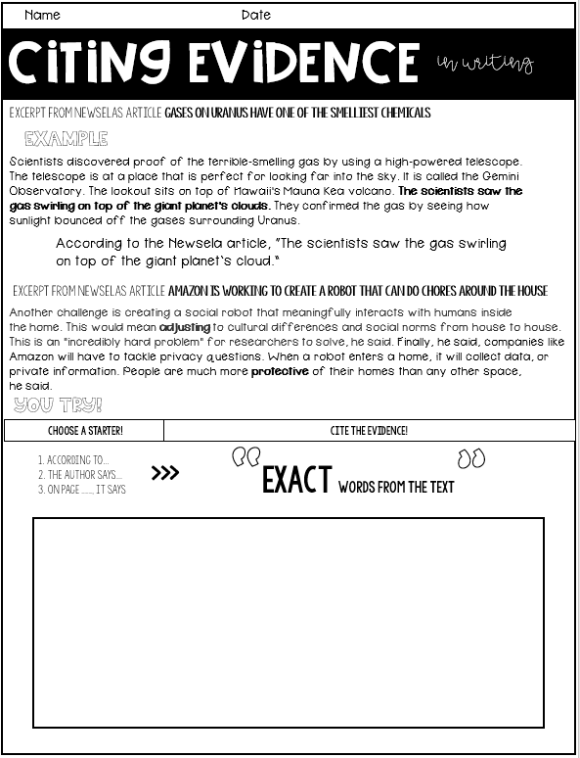
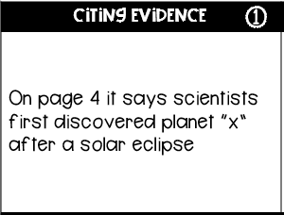
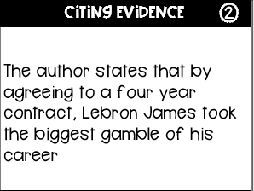
CCSS.ELA-LITERACY.W.5.2.B
CCSS.ELA-LITERACY.W.6.1
Citing evidence
How to properly cite evidence in any
written response
Includes
-Step-by-step directions on how to cite evidence with excerpts
-I do, we do, you do practice -Convention practice

Slide 2
Name Date
Citing evidence
in writing
I can properly cite evidence from a text in my writing!
Choose a starter!
Cite the evidence!
1. According to…
2. The author says…
3. On page ___, it says
x
“exact Words from the text”
Use quotations at the beginning and ending when you take the exact words from a text!
a
“exact Words from the text”
t
When citing evidence, make sure to write down the exact (same) words, in the same order, as when you read it!
So how do I cite evidence?
Step 1: Choose a starter
Step 2: Write quotation marks
step 3: write exactly what the text says.
step 4: end with quotation marks!

Slide 3
Name Date
Citing evidence
in writing
Excerpt from Newselas article Gases on Uranus have one of the smelliest chemicals
Example
Scientists discovered proof of the terrible-smelling gas by using a high-powered telescope. The telescope is at a place that is perfect for looking far into the sky. It is called the Gemini Observatory. The lookout sits on top of Hawaii's Mauna Kea volcano. The scientists saw the gas swirling on top of the giant planet's clouds. They confirmed the gas by seeing how sunlight bounced off the gases surrounding Uranus.
According to the Newsela article, “The scientists saw the gas swirling on top of the giant planet’s cloud.”
Excerpt from Newselas article Amazon is working to create a robot that can do chores around the house
Another challenge is creating a social robot that meaningfully interacts with humans inside the home. This would mean adjusting to cultural differences and social norms from house to house. This is an "incredibly hard problem" for researchers to solve, he said. Finally, he said, companies like Amazon will have to tackle privacy questions. When a robot enters a home, it will collect data, or private information. People are much more protective of their homes than any other space, he said.
You try!
Choose a starter!
Cite the evidence!
“exact Words from the text”
x
1. According to…
2. The author says…
3. On page ___, it says

Slide 4
Name Date
Citing evidence
in writing
Choose a starter!
Cite the evidence!
“exact Words from the text”
x
1. According to…
2. The author says…
3. On page ___, it says
Excerpt from Newselas article Amazon is working to create a robot that can do chores around the house
It's the journey of a lifetime for the aspiring striker and eight other Indonesian kids set to compete against teams of other disadvantaged children from two dozen nations.This the third year the event has taken place. It is in Moscow. Somad lives in a town called Bekasi in the outskirts of Indonesia's capital city of Jakarta. In Jakarta, Somad's father sorts through foul trash heaps to find and sell usable goods.
Excerpt from Newselas article Street side: Indonesia slum kids eye youth "World Cup”
The slum is mostly populated by trash pickers. They live in its hundreds of shacks. A potent smell of garbage is everywhere in the district where stray animals wander along its muddy roads.
More than 200 children are participating in the seven-a-side tournament. It begins ahead of this year's Russia-hosted World Cup.

Slide 5
Practice
*laminate, cut and use dry erase markers to practice correctly citing evidence.*
Citing Evidence
1
Citing Evidence
2
The author states that by agreeing to a four year contract, Lebron James took the biggest gamble of his career
On page 4 it says scientists first discovered planet “x” after a solar eclipse
Citing Evidence
3
Citing Evidence
4
According to the passage much of Uruguay's wildlife has disappeared as a result of competition for land with humans
The text says scientists today believe dinosaurs are the ancestors of birds
Citing Evidence
5
Citing Evidence
6
For example burt has made images showing what Anna, Elsa, Moana, Rapunzel and the rest of the heroines might be doing as women in the workplace.
In addition the author also writes with so many live-action superhero options, do the Incredibles still matter?

Slide 6
Supporting Visuals
Choose a starter!
Cite the evidence!
“exact Words from the text”
1. According to…
2. The author says…
3. On page ___, it says
x
in writing
Scientists discovered proof of the terrible-smelling gas by using a high-powered telescope. The telescope is at a place that is perfect for looking far into the sky. It is called the Gemini Observatory. The lookout sits on top of Hawaii's Mauna Kea volcano. The scientists saw the gas swirling on top of the giant planet's clouds. They confirmed the gas by seeing how sunlight bounced off the gases surrounding Uranus.
x
According to the NewsEla article, “The scientists saw the gas swirling on top of the giant planet’s cloud.”
Choose a starter!
Cite the evidence!
“exact Words from the text”
1. According to…
2. The author says…
3. On page ___, it says
x
in writing
Scientists discovered proof of the terrible-smelling gas by using a high-powered telescope. The telescope is at a place that is perfect for looking far into the sky. It is called the Gemini Observatory. The lookout sits on top of Hawaii's Mauna Kea volcano. The scientists saw the gas swirling on top of the giant planet's clouds. They confirmed the gas by seeing how sunlight bounced off the gases surrounding Uranus.
x
According to the NewsEla article, “The scientists saw the gas swirling on top of the giant planet’s cloud.”
Choose a starter!
Cite the evidence!
“exact Words from the text”
1. According to…
2. The author says…
3. On page ___, it says
x
in writing
Scientists discovered proof of the terrible-smelling gas by using a high-powered telescope. The telescope is at a place that is perfect for looking far into the sky. It is called the Gemini Observatory. The lookout sits on top of Hawaii's Mauna Kea volcano. The scientists saw the gas swirling on top of the giant planet's clouds. They confirmed the gas by seeing how sunlight bounced off the gases surrounding Uranus.
x
According to the NewsEla article, “The scientists saw the gas swirling on top of the giant planet’s cloud.”

