Slide 1
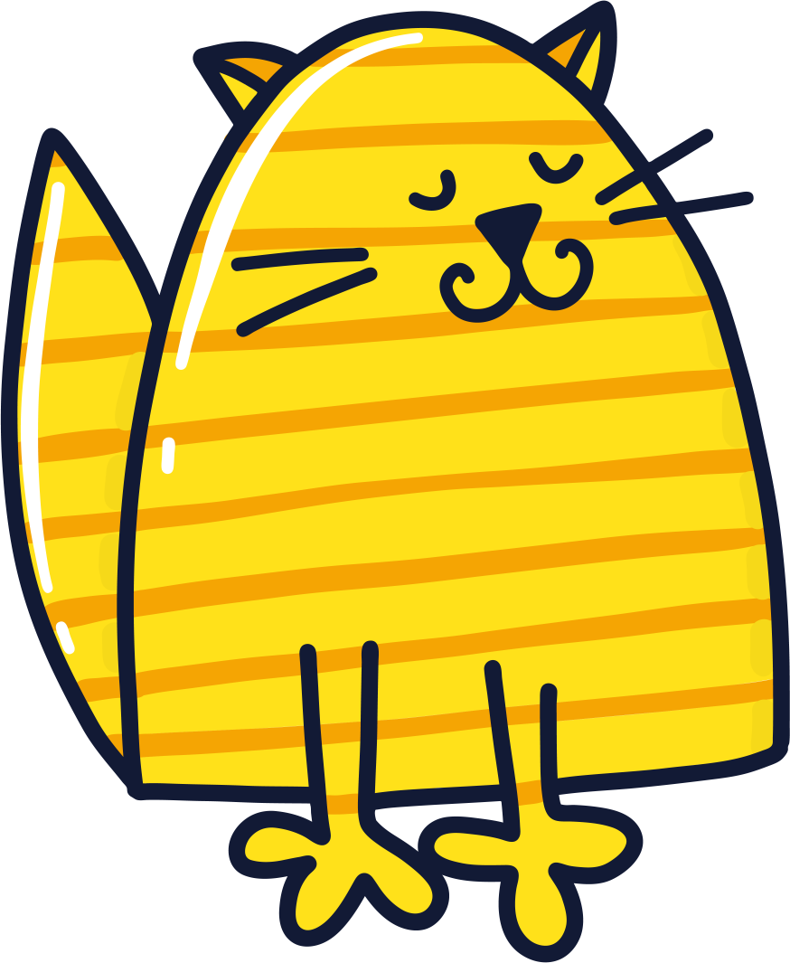
a
“a” like cat

Slide 2
e
“e” like pencil

Slide 3
i
“i” like fish

Slide 4
o
“o” like fox

Slide 5
u
“u” like sun

