Slide 1
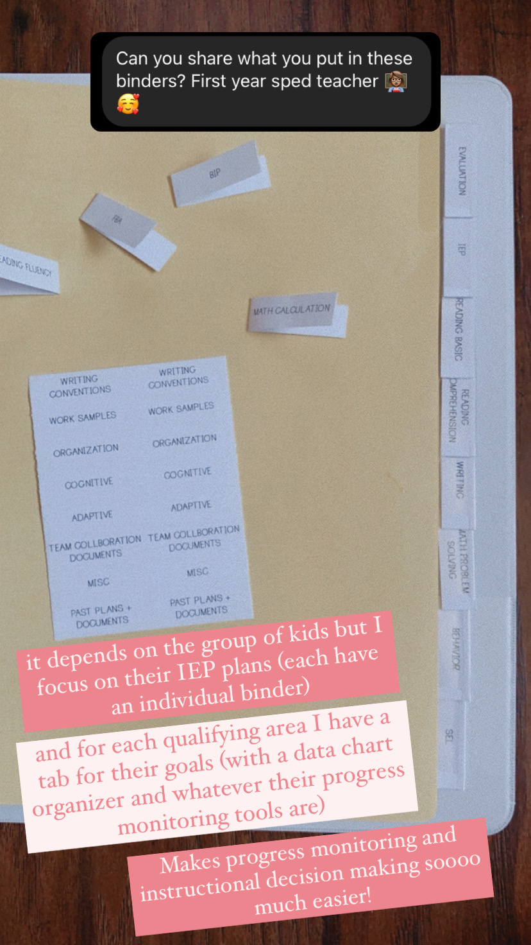
about the binders
I use 2 inch binders --> here
I use Avery 8 tab binder dividers → here
-any tabs you purchase can be printed on by downloading the template from their brand website.
For the cover and siding I print on white card stock
I print double sided for the data collection tracking inserts
Progress monitoring tools are specific to each goal and IEP, but I include them right after the data tracking insert
From my instastory

Slide 2
program name
NAME
Iep binder

Slide 3
2 inch binder
name
name
name
name
IEP BINDER
IEP BINDER
IEP BINDER
IEP BINDER

Slide 4
1 inch binder
name
name
name
name
name
name
name
IEP BINDER
IEP BINDER
IEP BINDER
IEP BINDER
IEP BINDER
IEP BINDER
IEP BINDER

Slide 5
subject
subject
Big Tab Inserts for Dividers, 8-Tab
1/2" x 1-1/2”
Template Avery 11124
(I would recommend downloading from Avery’s website)
subject
subject
subject
subject
subject
subject
subject
subject
subject
subject
subject
subject
subject
subject
subject
subject
subject
subject
subject
subject
subject
subject
subject
subject
subject
subject
subject
subject
subject
subject
subject
subject
subject
subject
subject
subject
subject
subject

Slide 6
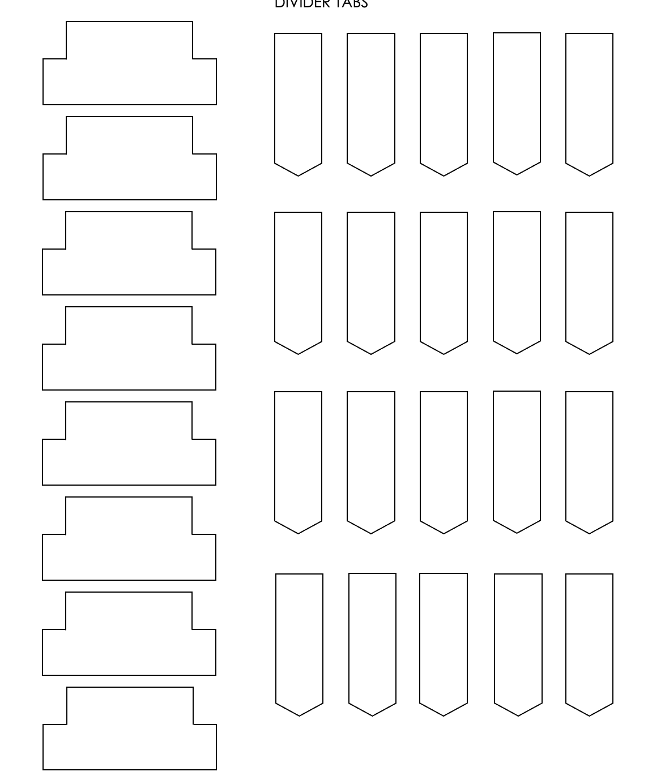
If you wanted to print and create your own--- I’ve used these in the past

Slide 7
GOAL AREA
IEP GOAL
specific area
GRAPH IT!
B
TRACK IT!
MEASUREMENT:
DATE | DATA POINT | NOTES
DATE | DATA POINT | NOTES

Slide 8
GRAPH IT!
TRACK IT!
MEASUREMENT:
DATE | DATA POINT | NOTES
DATE | DATA POINT | NOTES

Slide 9
READING
IEP GOAL
specific area
GRAPH IT!
B
TRACK IT!
MEASUREMENT:
DATE | DATA POINT | NOTES
DATE | DATA POINT | NOTES

Slide 10
GRAPH IT!
TRACK IT!
MEASUREMENT:
DATE | DATA POINT | NOTES
DATE | DATA POINT | NOTES

Slide 11
WRITING
IEP GOAL
specific area
GRAPH IT!
B
TRACK IT!
MEASUREMENT:
DATE | DATA POINT | NOTES
DATE | DATA POINT | NOTES

Slide 12
GRAPH IT!
TRACK IT!
MEASUREMENT:
DATE | DATA POINT | NOTES
DATE | DATA POINT | NOTES

Slide 13
MATH
IEP GOAL
specific area
GRAPH IT!
B
TRACK IT!
MEASUREMENT:
DATE | DATA POINT | NOTES
DATE | DATA POINT | NOTES

Slide 14
GRAPH IT!
TRACK IT!
MEASUREMENT:
DATE | DATA POINT | NOTES
DATE | DATA POINT | NOTES

